Slide 1
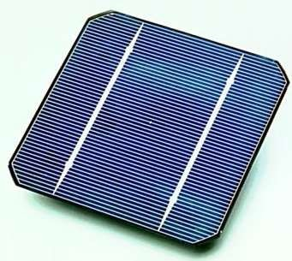
PHOTOVOLTAIC SYSTEM

Slide 2
Photovoltaic system
A photovoltaic system, also photovoltaic power system, solar PV system, PV system or casually solar array, is a power system designed to supply usable solar power by means of photovoltaics.
Photovoltaics (PV) is a method of converting solar energy into direct current electricity using semiconducting materials that exhibit the photovoltaic effect. A photovoltaic system employs solar panels composed of a number of solar cells to supply usable solar power. Power generation from solar PV has long been seen as a clean sustainable energy technology which draws upon the planet’s most plentiful and widely distributed renewable energy source – the sun.

Slide 3
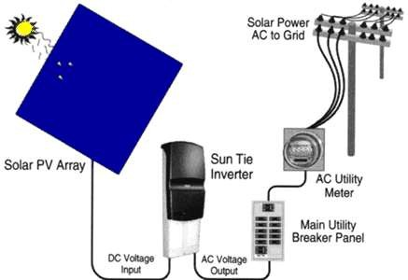
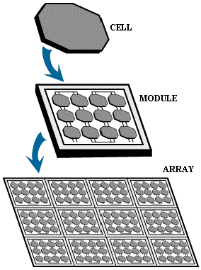
Photovoltaic System

Slide 4
Components
◆ Solar array
◆ Cabling
◆ Mounting systems
◆ Solar trackers
◆ Solar inverters
◆ Charge controller
◆ Battery

Slide 5
Tracking
◆ Fixed or tracking array The PV array may either be fixed, sun- tracking with one axis of rotation, or sun-tracking with two axes of rotation. The default value is a fixed PV array.
◆ PV array tilt angle (0° to 90°) For a fixed PV array, the tilt angle is the angle from horizontal of the inclination of the PV array (0° = horizontal, 90° = vertical). For a suntracking PV array with one axis of rotation, the tilt angle is the angle from horizontal of the inclination of the tracker axis. The tilt angle is not applicable for sun-tracking PV arrays with two axes of rotation.
◆ The default value is a tilt angle equal to the station's latitude.
This normally maximizes annual energy production. Increasing the tilt angle favours energy production in the winter, while decreasing the tilt angle favours energy production in the summer.

Slide 6
PV Technology Classification
Thin‐film Technology
Silicon Film Technology:- Monocrystalline Polycrystalline

Slide 7
Thin Film Technology
Silicon deposited in a continuous on a base material such as glass, metal or polymers
The efficiency ranges from 5% to 13%
Thin-film crystalline solar cell consists of layers about 10μm thick compared with 200-300μm layers for crystalline silicon cells
◆ PROS
Low cost substrate and fabrication process
◆ CONS
Not very stable

Slide 8
Silicon Crystalline Technology
Currently makes up 86% of PV market
Very stable with module efficiencies 10-16%
Monocrystalline Si cells:
Poly Crystalline PV Cells
The production of these cells is economically more efficient compared to monocrystalline. The efficiency ranges from 10% to 14%.
conversion efficiency for this type of cells ranges from 13% to 17%, and can generally be said to be in wide commercial use. In good light conditions it is the most efficient photovoltaic cel

Slide 9
Working of Solar cell
◆ photovoltaic (PV) cells are made up of at least 2 semi-conductor layers. One layer containing a positive charge, the other a negative charge.
◆ Sunlight consists of little particles of solar energy called photons. As a PV cell is exposed to this sunlight, many of the photons are reflected, pass right through, or absorbed by the solar cell.
◆ When enough photons are absorbed by the negative layer of the photovoltaic cell, electrons are freed from the negative semiconductor material. Due to the manufacturing process of the positive layer, these freed electrons naturally migrate to the positive layer creating a voltage differential, similar to a household battery.
◆ When the 2 layers are connected to an external load, the electrons flow through the circuit creating electricity. Each individual solar energy cell produces only 1-2 watts. To increase power output, cells are combined in a weather-tight package called a solar module. These modules (from one to several thousand) are then wired up in
serial and/or parallel with one another, into what’s called a solar array, to create the desired voltage and amperage
output required by the given project.

Slide 10
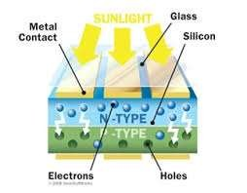
Construction of solar cell
Glass
Metal contact
P-n junction
p-type semi conductor
N-type semi conductor

Slide 11
◆ In p-type semiconductors, holes are the majority carriers and electrons are the minority carriers. P-type semiconductors are created by doping an
intrinsic semiconductor with acceptor impurities (or doping a n-type semiconductor). A common p-type dopant for silicon is boron.
◆ N-type semiconductors have a larger electron concentration than hole concentration. The phrase 'n-type' comes from the negative charge of the electron. In n-type semiconductors, electrons are the majority carriers and holes are the minority carriers.). A common dopant for n-type silicon is phosphorus.

Slide 12
Applications @ PV
◆ Commercial Lighting: PV powered lighting systems are reliable and low cost alternative. Security, billboard sign, area, and outdoor lighting are all viable applications for PV
◆ Consumer electronics: Solar powered watches, calculators, and cameras are all everyday applications for PV technologies.
◆ Telecommunications
◆ Residential Power: A residence located more than a mile from the electric grid can install a PV system more inexpensively than extending the electric grid
(Over 500,000 homes worldwide use PV power as their only source
of electricity)

Slide 13
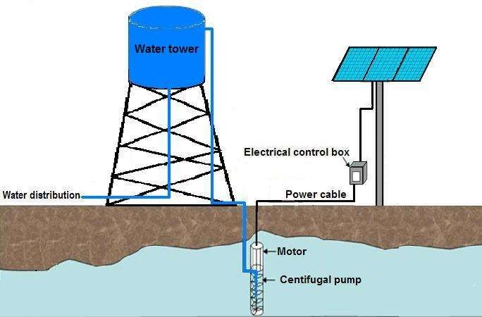
Water Pumping: PV powered pumping systems are excellent ,simple ,reliable – life 20 yrs

Slide 14
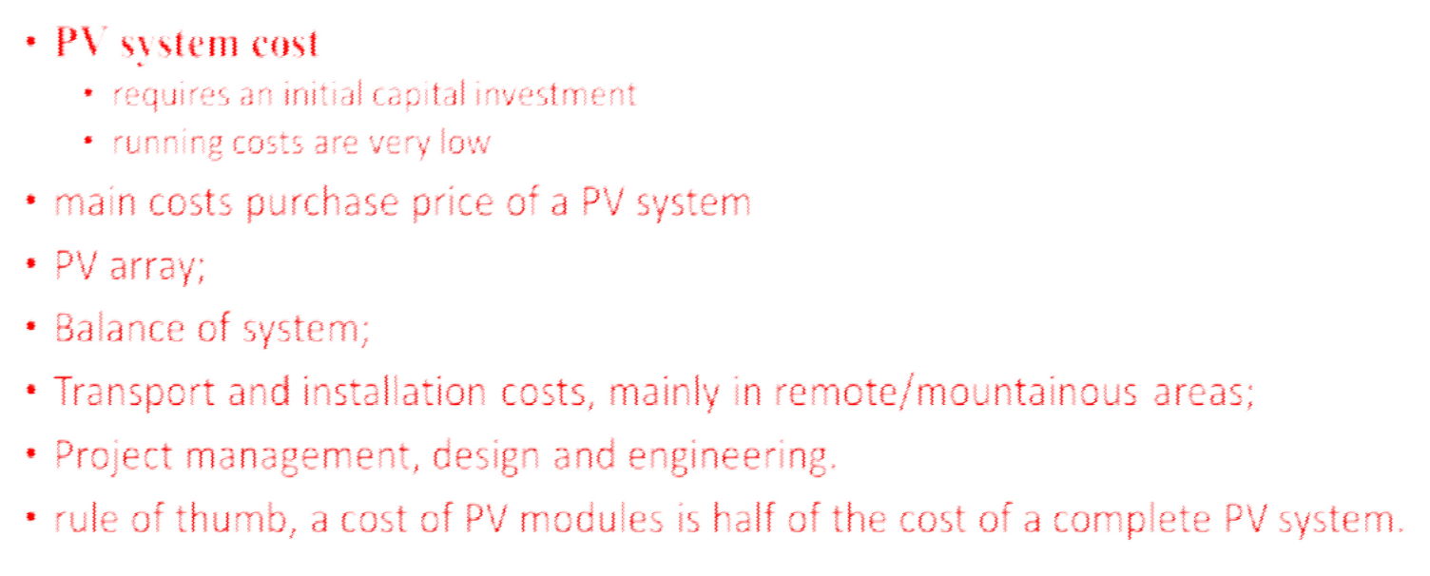
Economic

Slide 15
PV module costs
less than one third of the purchase price of a small stand-alone generator for rural electrification in remote location
costs of PV modules is above 3 €/Wp for crystalline Si modules and above 2 €/Wp for thin-film amorphous Si modules

Slide 16
Transport and installation costs
◆ The costs of transport and installation are particularly high in remote and mountainous areas. However, organisations, which work in such areas, are aware of these costs, but they are attracted by the modular nature of PV generators, which can be transported easily.

Slide 17
Project management, design and engineering costs
◆ These costs are falling as experience grows with the application of PV systems, and designs are becoming standardised. For example, "PV lighting kits" are now available for rural electrification applications, and PV powered water pumps are sold as packages.

Slide 18
Overall systems cost
Cost to be around 13 €/Wp
The relative contributions of different PV system components for 1 kWp rooftop system are as follows:
•module 53%
•inverter 22%
•mounting 12%
• •rest 13%.
For grid-connected PV power stations up to 500 kWp the costs range from 8 to 16 €/Wp
Generally, the PV module costs average around 30% of the system cost, as compared to about 50% for thegrid- connected systems.

Slide 19
PV electricity cost
Estimate of the cost of electricity produced by a PV system may be
determined from:
• •
cost of electricity unit [€/kWh] is calculated
Electricity cost = Cost (System + O&M)/(Yield × Installed power ×
Payback period)
•installed system price [€],
•total operating and maintenance (O&M) costs over the system lifetime [€] (often negligible apart from battery replacement costs),
•installed system nominal power output [Wp]
•annual yield [kWh/(year × kWp)
payback period [years] (dependent on the rate of return and the predicted lifetime of the system).

Slide 20
Growth of photovoltaics

Slide 21
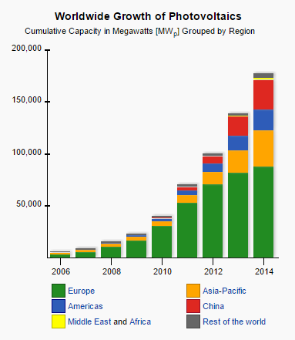

Slide 22
Timeline
◆ 1839 - Alexandre Edmond Becquerel observes the photovoltaic effect via an electrode in a conductive solution exposed to light.
◆ 1887 - Heinrich Hertz investigates ultraviolet light photoconductivity and discovers the photoelectric effect
◆ 1888-91 - Aleksandr Stoletov creates the first solar
cell
◆ 1905 - Albert Einstein publishes a paper explaining the photoelectric effect on a quantum basis.
◆ 1954 - Bell Labs announces the invention of the first practical silicon solar cell. These cells have about 6% efficiency.
◆ 1960 - Hoffman Electronics creates a 14% efficient solar cell.

Slide 23
◆ 1988 - The Dye-sensitized solar cell is created by Michael Grätzel and Brian O'Regan. These
photoelectrochemical cells work from an organic dye compound inside the cell and cost half as much as silicon solar cells.
◆ 1989 - Reflective solar concentrators are first used
with solar cells
◆ 1999 - Total worldwide installed photovoltaic power reaches 1,000 megawatts.
◆ 2012 - 3D PV-cell with 30% more energy efficiency.

Slide 24
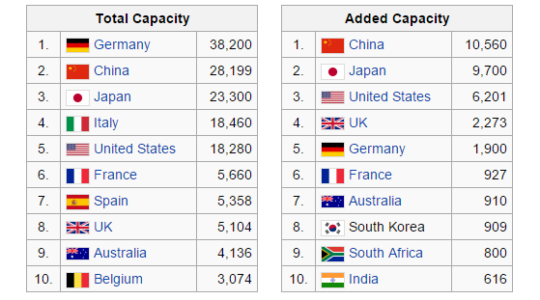
Current Status
◆ Top 10 PV-Countries of Year 2014 in (MW)
Data: IEA-PVPS Snapshot of Global PV 1992–2014 report

Slide 25
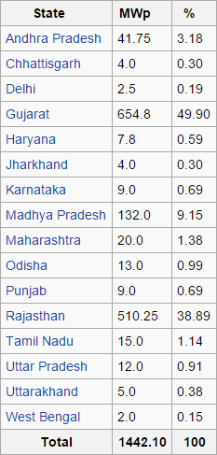
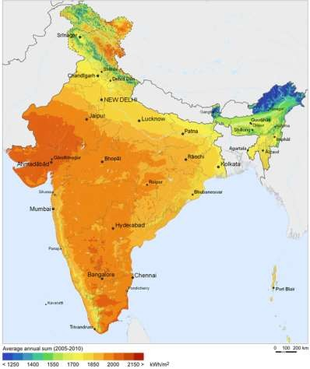
Meanwhile in India…
India’s solar resources

Slide 26
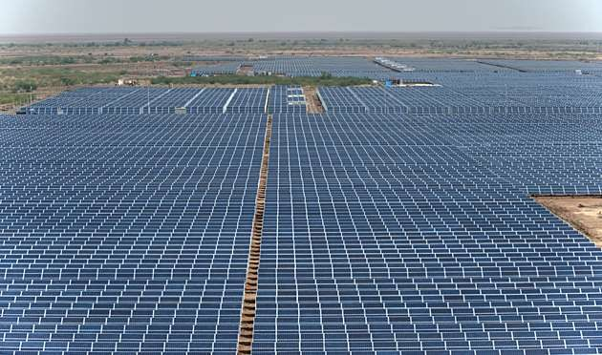
India’s and Asia’s largest Solar Park at 600 MW, located at Charanka, Gujarat

Slide 27
Top photovoltaic companies in India
Rank | Company | Revenue (in ₹ million)
1 | Tata Power Solar Systems Ltd. | 5104.67
2 | Vikram Solar Pvt. Ltd. | 3815.74
3 | Emmvee Group | 3619.11
4 | Waaree Energies Ltd. | 2975.94
5 | Moser Baer Solar Group | 2421.67

Slide 28
Government Support
◆ The Ministry of New and Renewable Energy provides 30 percentage subsidy on the installation cost of a solar photovoltaic power plant.
◆ 51 Solar Radiation Resource Assessment stations have been installed across India by the MNRE to monitor the availability of solar energy.
◆ The GoI has also encouraged private solar companies by reducing customs duty on solar panels by 5% and exempting excise duty on solar photovoltaic panels.

Slide 29
Some key environmental concerns…
◆ Crystalline silicon is made using silane gas, the production of which results in waste silicon tetrachloride which is toxic.
◆ Sulphur Hexafluoride is used to clean the reactor used in silicon production. If it escaped it would be a very potent greenhouse gas.
◆ Disposal problems of hazardous semiconductor material
◆ The use of lead-based solder would lead to pollution problems if items are sent to landfill or incineration
◆ Some kinds of PV panel contain Cadmium, which is an
extremely toxic metal
In spite of all these environmental concerns, Solar Photovoltaic is one of the cleanest forms of energy

Slide 30



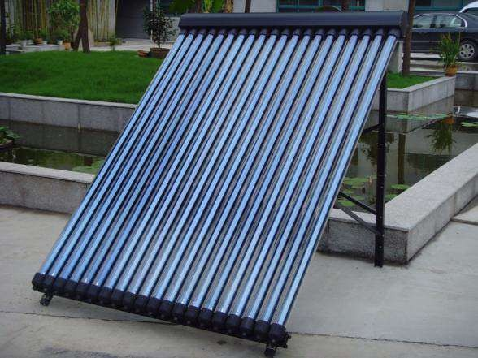
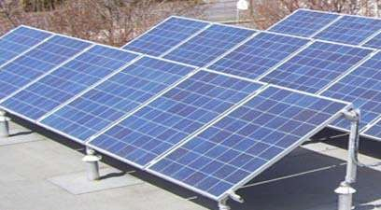
PhotoVoltaic System in IIT Roorkee

Slide 31
Brief detail of Program
◆ The Government had launched the Jawaharlal Nehru National Solar Mission, which was a major initiative of the Government of India and State Governments to promote ecologically sustainable growth while addressing India's energy security challenge.
◆ It will also constitute a major contribution by India to the global effort to meet the challenges of climate change. Various off-grid solar photo voltaic systems / applications up to a maximum capacity of 100 kWp per site and off-grid and decentralized solar thermal applications, to meet / supplement lighting, electricity/power, heating and cooling energy requirements would be eligible for being covered under the Scheme.

Slide 32

Benchmark Cost of Project
Chemical Engineering Department
No. of PV Modules: 518.0
Peak Power Output: 119.1 kWp Benchmark Cost: Rs 2,50,19,400 Approximate Savings: Rs 6,24,934 pa (@Rs 3.2 per kWh)
The total benchmark cost for the system in IIT Roorkee is Rs 38 crore (approx).
Maximum subsidy that can be availed @90% = Rs. 34, 19, 78,490
= Rs 34 crore (approx)

Slide 33
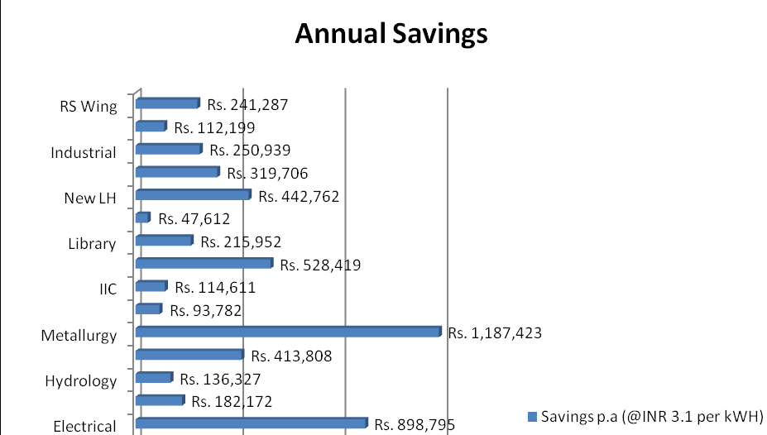

Slide 34

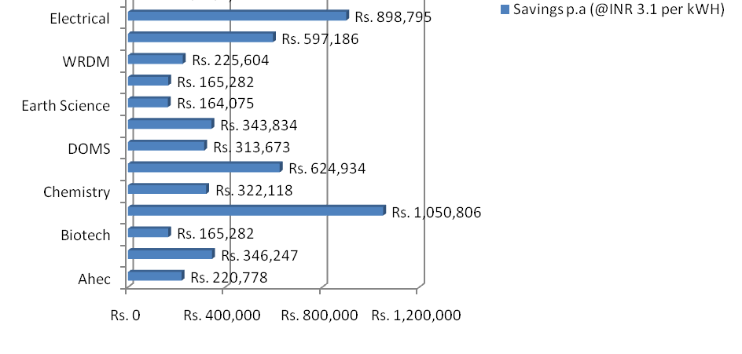
Annual Saving

Slide 35
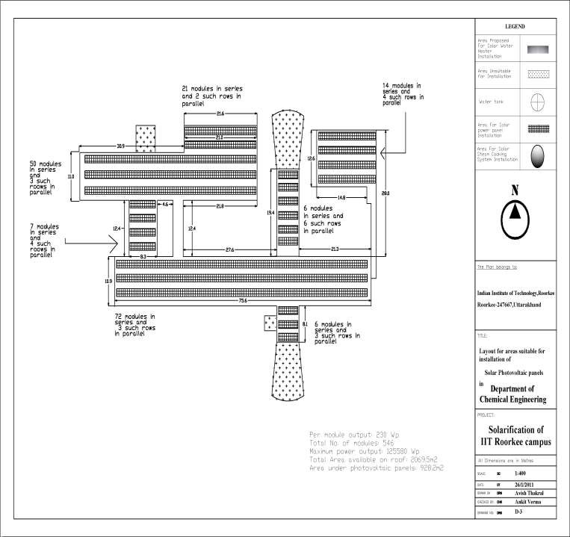



Chemical Engineering Department
PV Panel arrangement

Slide 36
Total Economic Analysis
Solar Photovoltaic Systems Capital Cost at Benchmark Price Subsidy
Actual Capital Cost
Savings per annum
Payback Period (Years)
Rs.38,06,52,300 Rs.34, 19, 78,490 Rs.3,80,65,230.0 Rs.97,25,613
3.9 years or 3 years 11 months

Slide 37
Indian PV Era
With energy demand continually increasing, along with the
need for
new and clean energy sources, solar energy will definitely be an important part of the future energy mix.
◆ Arid regions receive plentiful solar radiation, regions like Rajasthan, Gujarat and Haryana receive sunlight in plenty.
◆ IREDA is planning to electrify 18,000 villages mainly through solar PV systems
◆ Targets have been set for the large scale utilization of PV technology by different sectors within the next five years

Slide 38
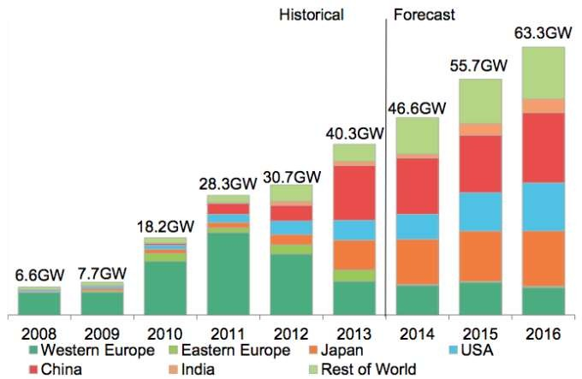
Expected Future of Solar Electrical Capacities

Slide 39
By 2020 global solar output could be 276 Terawatt hours, which would equal 30% of Africa's energy needs or 1% of global demand. This would replace the output of 75 new coal fired power stations. The global solar infrastructure would have an investment value of US$75 billion a year. By 2040 global solar output could be more than 9000 Terawatt hours, or 26% of the expected global demand
A new world record conversion efficiency: the multi- junction solar cell co-developed by Soitec, CEA-Leti and Fraunhofer Institute for solar Energy Systems ISE has reached a conversion efficiency of 46%, marking the world’s new recordean Photovoltaic Industry Association (EPIA) and Greenpeace

Slide 40
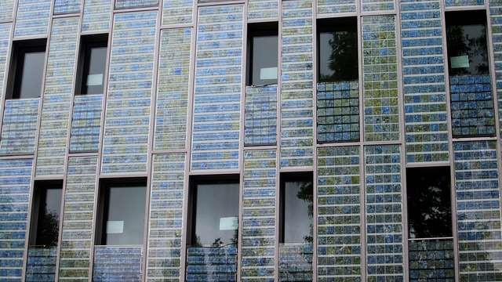
The new product is suitable to be installed on buildings and car roofs for solar generation and glare
A building with facade covered by solar cells in Paris. (Photo Credit:La Citta Vita via Fli_{r}ck_{e}r)_{duction.}
To overcome silicon solar cells’ color and light- shading limitations, many researchers have endeavored for developing solar cells using various materials and technologies. For example, thin-film solar cells are one of the candidates for solar windows because they have better transmittancy than silicon cells

Slide 41
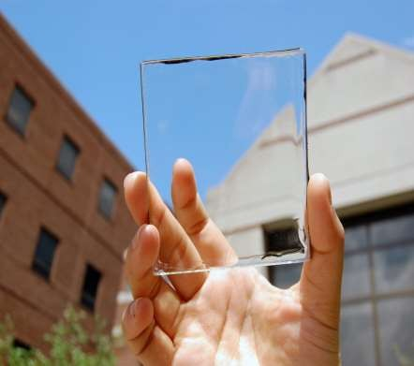
A research team at Michigan State University has developed a “transparent luminescent solar concentrator” that absorbs only ultraviolet and near infrared wavelengths to generate power – allowing the solar cell to be almost transparent. The efficiency, which is as low as around 1%, is the major defect and the team hopes to increase it up to around 5%.

Slide 42
Concluding Remarks
◆ The key to successful solar energy installation is to use quality components that have long lifetimes and require minimal maintenance.
◆ The future is bright for continued PV technology dissemination.
PV technology fills a significant need in supplying electricity, creating local jobs and promoting economic development in rural areas, avoiding the external environmental costs associated with traditional electrical generation technologies.
◆ Major power policy reforms and tax incentives will play a major role if all the above said is to be effectively realized.

Slide 43

“ By the year 2030, India should achieve Energy Independence through solar power and other forms of renewable energy ”
Dr. A. P. J. Abdul Kalam
Former President of India
Independence Day Speech, 2005
THE END

Slide 44

Bibliography
http://pv.energytrend.com/features/20141216-7939.html http://www.iitr.ac.in/departments/AH/pages/Projects+Sola r_Energy_use_in_IITR.html http://www.recgroup.com/en/tech/the-future-of-solar/ www.che.iitm.ac.in

